Slide 1







<Current scenario and future scenario of the Data analysis >
<Deep Shah>
<April 3rd.2023>

Slide 2



OUTLINE
Executive Summary
Introduction
Methodology
Results
Visualization – Charts
Dashboard
Discussion
Findings & Implications
Conclusion
Appendix

Slide 3

EXECUTIVE SUMMARY
•The top 3 current and future programming languages the respondents worked and wanted to work with were: Java Script, HTML/CSS, and SQL
•The Top 3 data bases the respondents worked with are: MySQL, Microsoft SQL Server, and PostgreSQL.
•However, in the future, the respondents wanted to work with PostgreSQL was the first, next was Mongo DB, and third was MySQL
•The top 3 cloud platforms the respondents worked with were: Windows, Linux, and Docker
•Yet, in the future, the respondents wanted to work with Linux, Docker, and AWS.
•The top 3 Web Frames the respondents worked with were: jQuery, Angular/Angular.js, and React.js
•But, in the future, the respondents wanted work with React.js, Vue.js, and Angular/Angular.js

Slide 4

INTRODUCTION
What technological languages, tools, and platforms would be used by programmers in the future?
The problem: There are many languages, tools, and platforms being utilized by professionals
What specific programming languages, databases, Cloud platforms and Web Frames programmers use and want to use in the future?

Slide 5

METHODOLOGY
•Data source: Respondents from the US, Canada, the UK, Germany, France, Spain, India, Brazil, and Australia
•Info gathered:
•Gender
•Formal education level
•Age
•Current programming languages, databases, cloud platforms, and Web Frames the participants are using,
•Future programming languages, databases, cloud platforms, and Web Frames the participants wanted work next year
•Other visualization tools such as Bar, line, and pie charts to visualize comparison of data

Slide 6
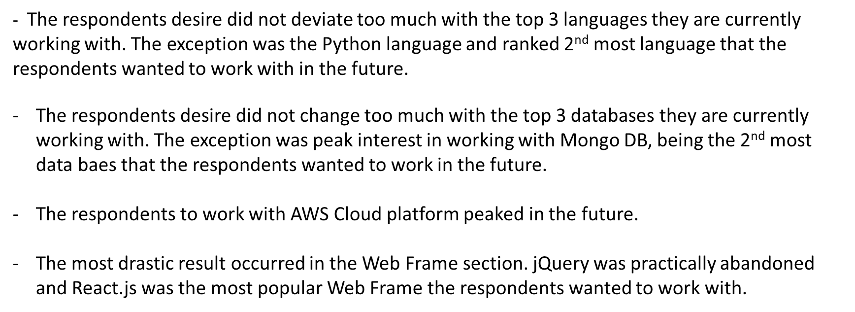
RESULTS

Slide 7
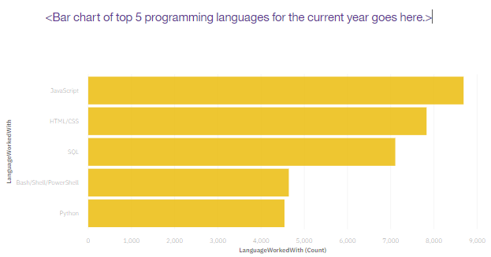
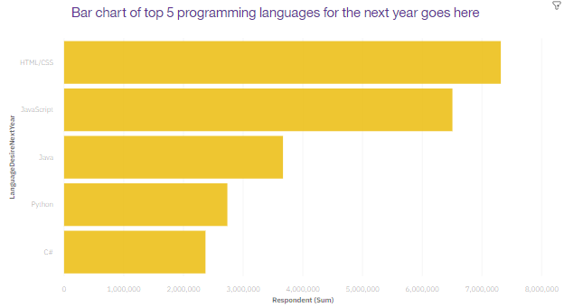
PROGRAMMING LANGUAGE TRENDS
Current Year
Next Year

Slide 8
PROGRAMMING LANGUAGE TRENDS - FINDINGS & IMPLICATIONS
Findings
•JavaScript is still the most popular programming language the respondents want to work right now and in the future
•
•Demand for Python is increasing
•
•Bash seems to be losing interests of the respondents
Implications
•Increase in Python demand may mean Python is an easy language to use
•
•Decrease in Bash demand may mean it is slowly being outdated
•
•JavaScript being popular through out the research means it may be the most fit

Slide 9
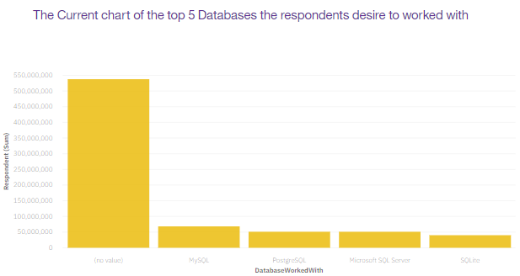
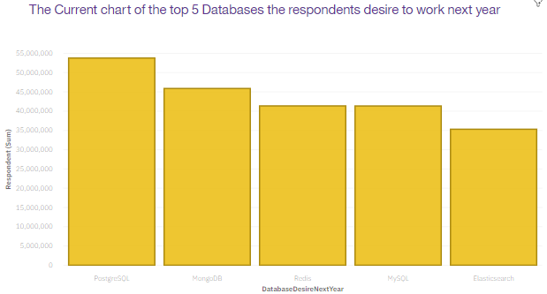
DATABASE TRENDS
Current Year
Next Year

Slide 10
DATABASE TRENDS - FINDINGS & IMPLICATIONS
Findings
•Demand to work with Postgre SQL spiked in the future, as well as the Mongo DB
•
•SQ Lite and Microsoft SQL server databases disappeared in the future works. They were replaced by Redis and Elasticsearch
•
•MySQL was the leader, but fell to 3rd most desired database the respondents wanted to work with
Implications
•Services being offered by SQ Lite and Microsoft SQL server may be inadequate or inconsistent
•
•Postgre SQL and MongoDB may be offering better features and reliable services
•
•MySQL is still useful, but may be slowly being outdated.

Slide 11

DASHBOARD
The link towards the Cognos Analytic visualization tool
https://dataplatform.cloud.ibm.com/dashboards/ad1e1101-c884-4701-b032-6c7ec0238490?project_id=fa35c21a-1999-4bd8-bff6-41bdb22b7d63&userfs=false&context=cpdaas&mode=consumption

Slide 12
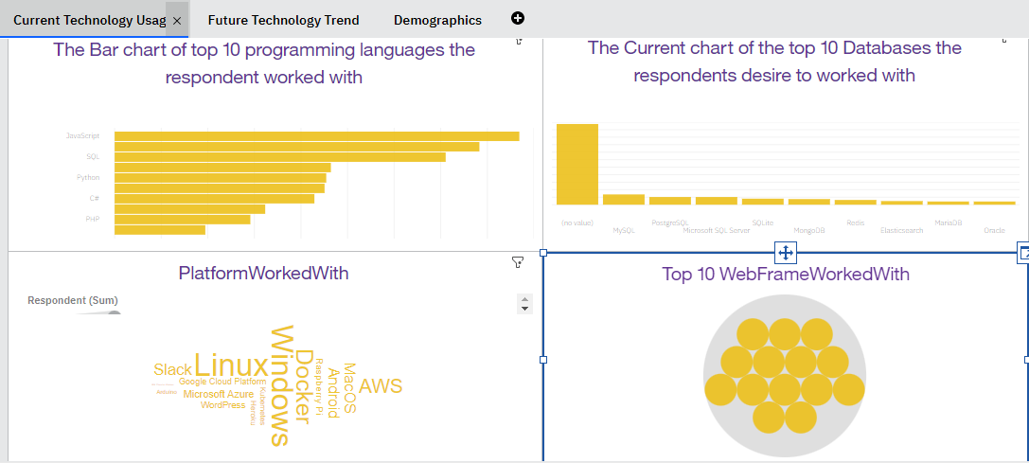
DASHBOARD TAB 1

Slide 13
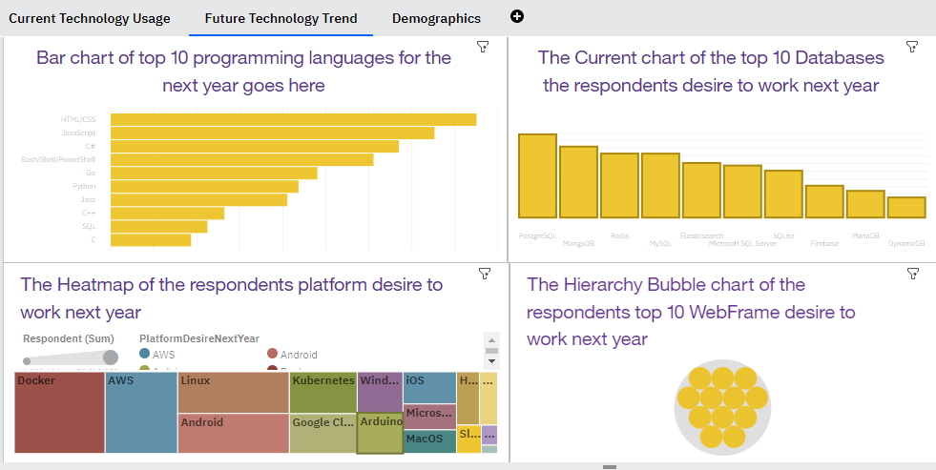
DASHBOARD TAB 2

Slide 14
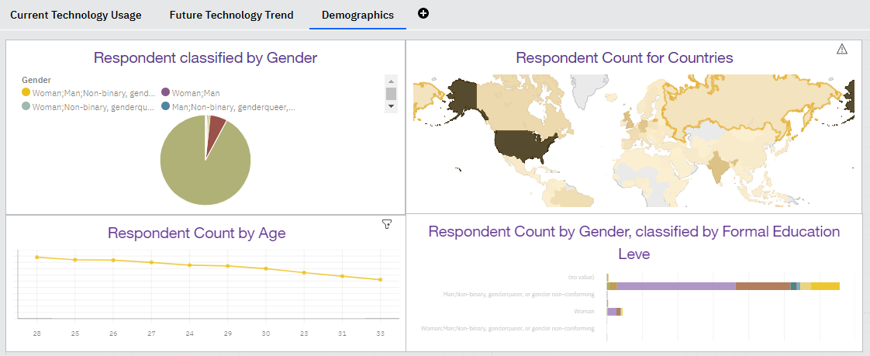
DASHBOARD TAB 3

Slide 15
DISCUSSION
•What would be the causes for the respondents to abandon and move to different languages and data bases?
•
•Why Javascript still remains popular programming language?
•
•Would the results would be different if we only gathered response from Masters degree and above?

Slide 16
OVERALL FINDINGS & IMPLICATIONS
Findings
•The world of technology is so dynamic that it’s rare to observe one language or database or cloud platform or WebFrame dominating certain area for long time.
•Men are primary users of the technology tools
•The age range of respondents were majority from 23~33. However, there were respondents who were age 16 from 99.
Implications
•Whatever or whichever services the technologies offer may need to be easy to use, reliable, and convenient to access
•Women may not be interested in Data entry/ Data organizations compared to men
People who identified as the age 99 may be hackers/ crackers or wanted to remain anonymous.

Slide 17

CONCLUSION
•Javascript is the most popular programming language tool
•
•Respondents who has Bachelor’s degree and/or Master’s degree are the primary users of technologies
•
•Currently, MySQL is the most popular data base the respondents use. Yet, they will eventually shift to PostgreSQL to perform database related tasks.
•
•Linux is the most popular cloud platform
•
•Currently, jQuery is the most popular Web Frames the respondents use. However, they will eventually work with React.js.

Slide 18
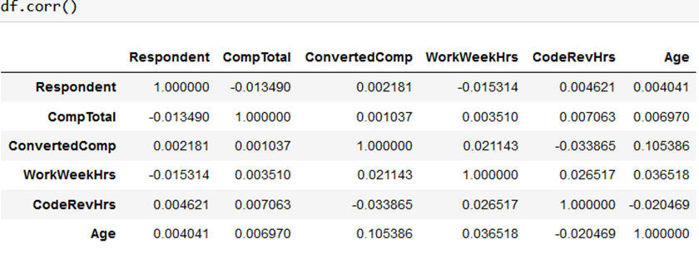

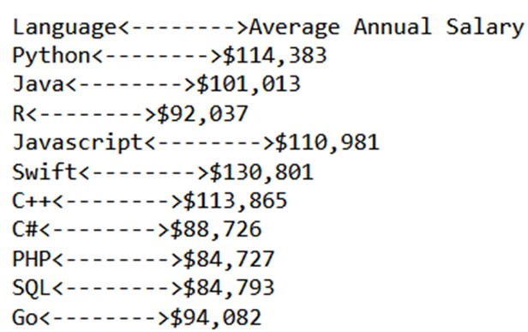
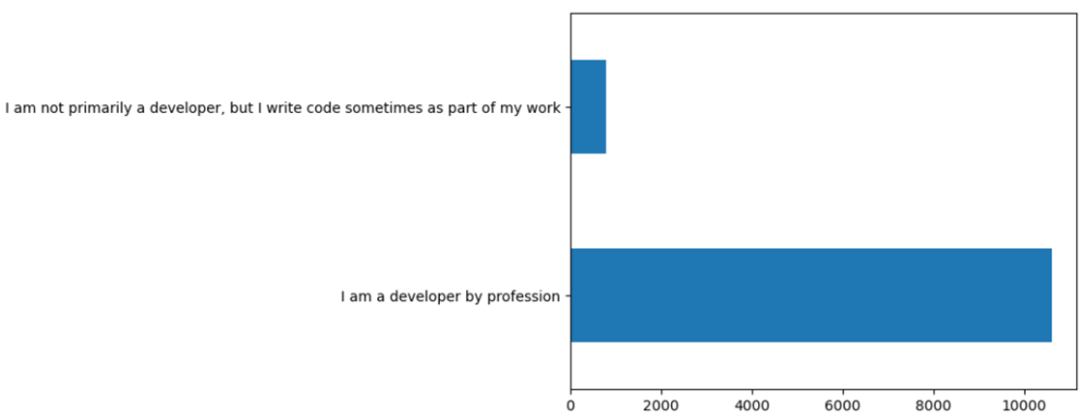
APPENDIX

Slide 19
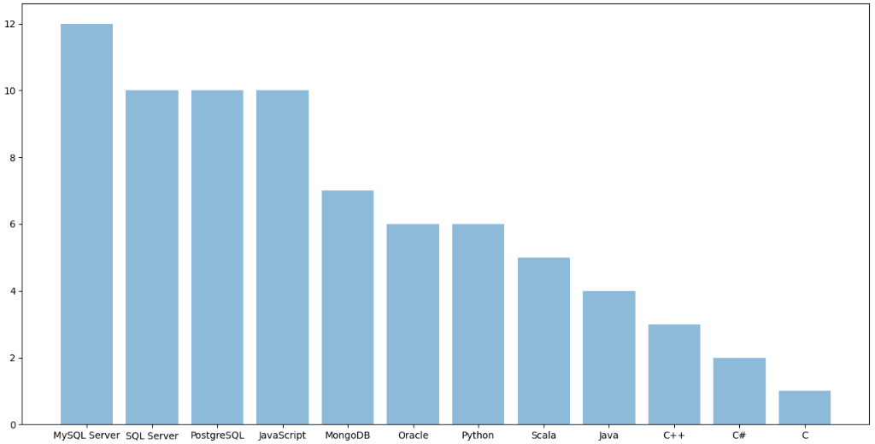
JOB POSTINGS

Slide 20
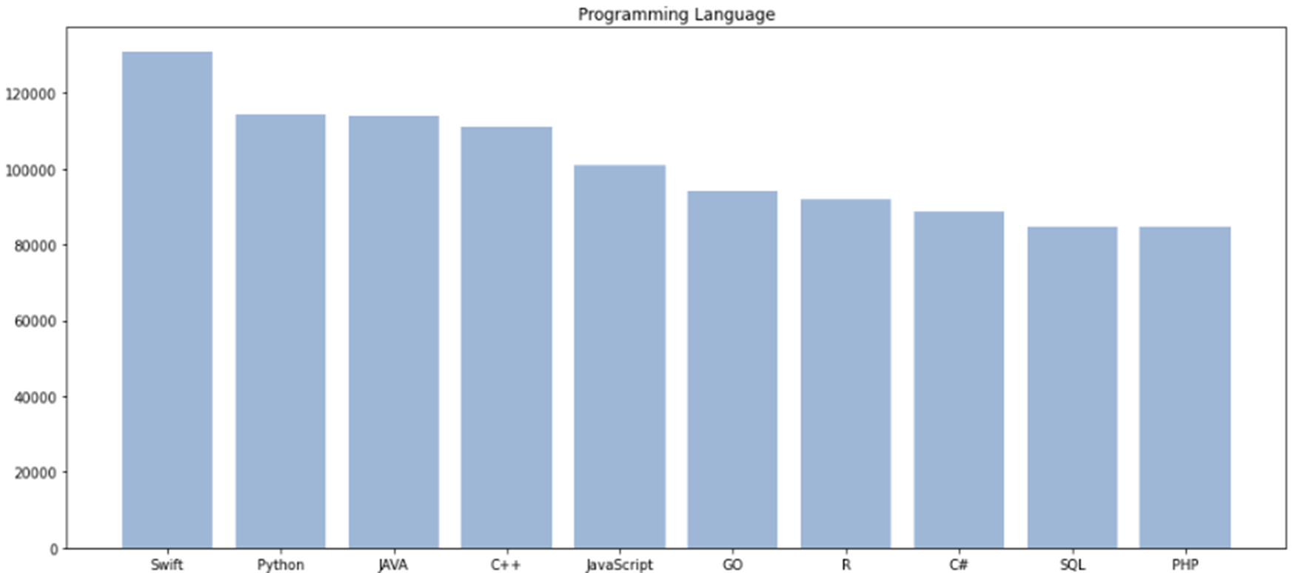
POPULAR LANGUAGES

